Slide 1
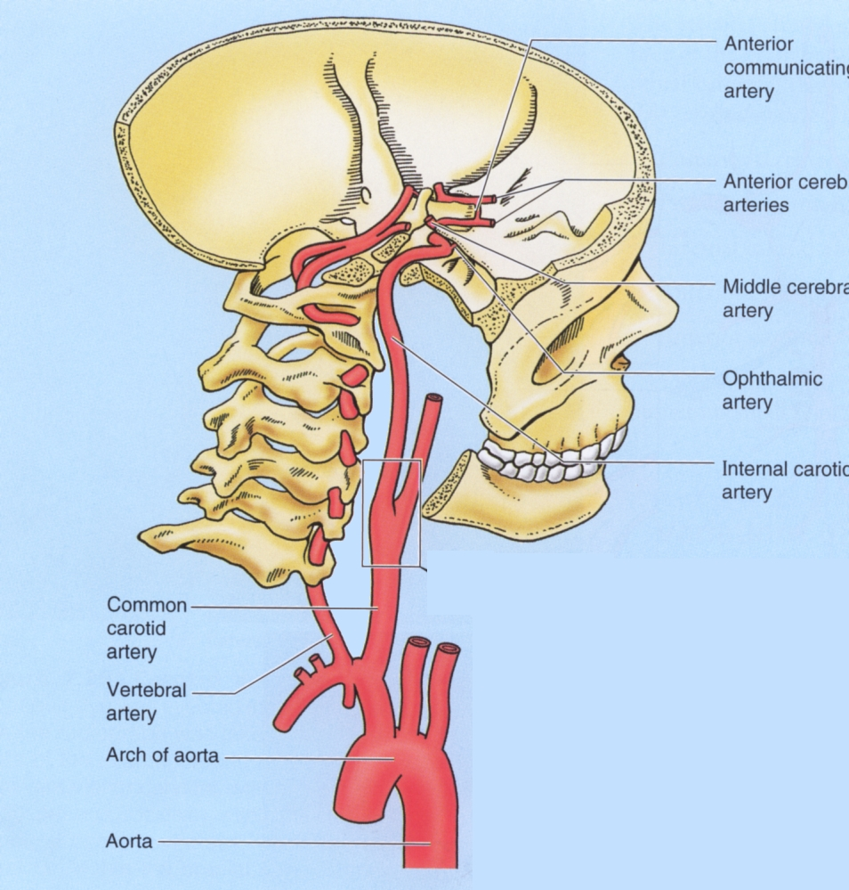
BLOOD SUPPLY OF BRAIN

Slide 2
Introduction:-
The brain is supplied by two system of arteries.
Vertebral system.
Carotid system.
Vertebral system- It consisting of pair of vertebral arteries.
Carotid system- It consisting of pair of internal carotid arteries.
The two vertebral arteries unite at the lower border of the pons to form Basilar artery.
Which ascends in the midline on the ventral surface of the pons and its upper border terminates by dividing in to right and left posterior cerebral arteries.

Slide 3
CIRCLE OF WILLIS (CIRCULUS ARTERIOSUS)
The branches of Basilar and internal carotid arteries get interconnected at the base of brain around the interpeduncular fossa forming six sided polygon of arteries called CIRCLE OF WILLIS
CIRCLE OF WILLIS is formed
Anteriorly- Anterior communicating and anterior cerebral arteries.
Posteriorly- The basilar artery dividing in to two posterior cerebral arteries.
Laterally- Posterior communicating artery connecting the internal carotid artery with the posterior cerebral artery.

Slide 4
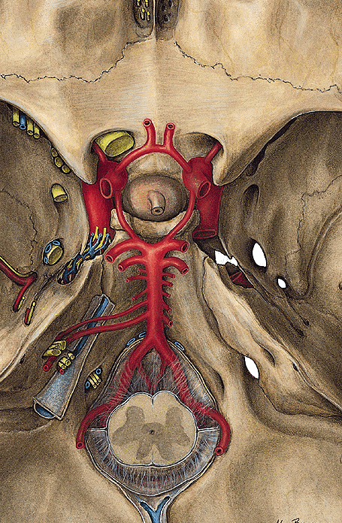
Circle of Willis

Slide 5
VERTEBRAL SYSTEM:-
The Vertebral artery a branch of subclavian artery.
It ascends in the foramina transversaria of upper 6 cervical vertebrae.
On reaching the base of the skull it winds backwards and medially around the lateral mass of the atlas and pierces the posterior atlanto- occipital membrane to enter the posterior cranial fossa through the foramen magnum.
Where it runs on the anterolateral aspects of the medulla.
Here the two vertebral arteries unite at the lower border of the pons to forms the Basilar artery.

Slide 6
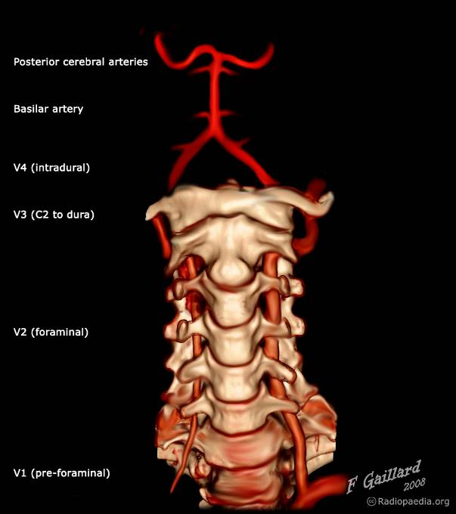
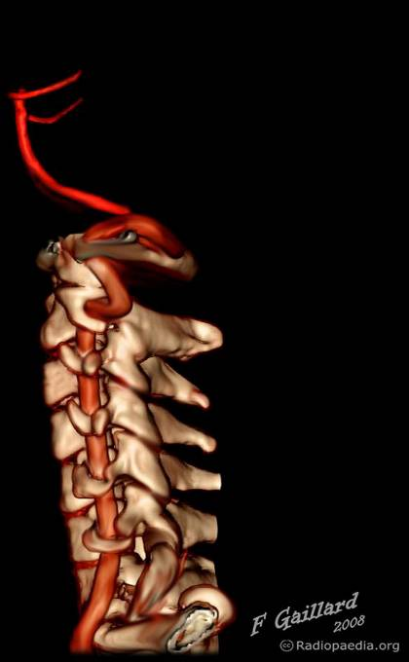
Vertebro-basilar system
CTA: CT angiography
atlas
laterally
upward
backward
axis
C6

Slide 7
Branches of the cranial part of the vertebral artery:-
Anterior Spinal artery
Posterior Spinal artery
Posterior inferior cerebellar artery
Meningeal branches.
Medullary arteries.
Anterior Spinal artery- It is a small branch arising near the termination of the vertebral artery.
It supply the anterior portion of spinal cord
Posterior Spinal artery- It arises from vertebral artery and sometimes from posterior inferior cerebellar artery.
It passes downward on the posterior surface of the spinal cord, after dividing in to two branches one along the medial side and other along the lateral side of the dorsal root of spinal nerve
Posterior inferior cerebellar artery- It is largest branch of the cranial part of the vertebral artery.

Slide 9
It arises near the lower end of the olive, winds back wards around the medulla oblongata and then ascends to the pontomedullary junction.
Branches from this artery supply the choroid plexus of the fourth ventricle.
Meningeal branches- These are small and supply the dura mater of the posterior cranial fossa.
Medullary arteries- These are several minute vessels which supply the medulla oblongata.
BASILAR ARTERY-
The two vertebral arteries unite at the lower border of the pons to form Basilar artery.
Which ascends in the midline on the ventral surface of the pons and its upper border terminates by dividing in to right and left posterior cerebral arteries.

Slide 10
Pontine branches.
Anterior inferior cerebellar artery.
Labyrinthine artery.
Superior cerebellar artery.
Posterior cerebral artery.
Pontine branches- These are numerous short slendor paramedian vessels which pierce the pons to supply.
Anterior inferior cerebellar artery- It arises closes to the lower border of the pons and runs backwards and laterally usually ventral to the 7th and 8th cranial nerve.
It supplies the anterolateral portion of the inferior surface of the cerebellum.

Slide 11
Labyrinthine artery- It is long slender branch which arises either from basilar artery or from anterior inferior cerebellar artery.
It accompanies the vestibulo-cochlear nerve and enters the internal auditory meatus to supply the internal ear.
Superior cerebellar artery- It arises close to the superior border of the pons runs laterally below the oculomotar nerve, wind round the cerebral peduncle below the trochlear nerve to reach the superior surface of the cerebellum which it supplies.

Slide 12
Posterior cerebral artery- It passes laterally parallel to the superior cerebellar artery, curve around the midbrain to reach the medial surface of the cerebral hemishere beneath the splenium of corpus callosum
The artery gives off temporal branches which ramify over the inferior surface of the temporal lobe and calcarine and parieto occipital branches.
Anterior temporal branch passes forwards
Posterior temporal branch passes posteriorly towards the ocipital pole.
Parito- ocipital branch runs towards the parito ocipital sulcus
Calcarine branch passes posteriorly in the calacarine sulcus.

Slide 13
CAROTID SYSTEM
The internal carotid artery is a terminal branch of the common carotid artery.
It traverses the carotid canal in the base of the skull and enters the middle cranial fossa beside the dorsum sellae of the sphenoid bone, finally it terminates by dividing in to two terminal branches.
A larger middle cerebral artery
Smaller anterior cerebral artery.

Slide 14
Branches of the cerebral part of the internal carotid artery:-
Ophthalmic artery
Posterior communicating artery.
Anterior choroidal artery
Anterior cerebral artery.
Middle cerebral artery.
Ophthalmic artery:- It arises from the ventral convexity of the carotid siphon and enters the optic canal to reach the orbital cavity to supply the structures of the orbit including eye ball.
Posterior communicating artery- It arises close to the termination of the internal carotid artery.
It runs backwards and anastomoses with the proximal part of the posterior cerebral artery

Slide 15
Anterior choroidal artery-It is long slender branch, which arises just distal to the origin of the posterior communicating artery.
It courses backwards above and along the optic tract to enter the inferior horn of the lateral ventricle through the choroid fissure to end in the choroid plexus.
Anterior cerebral artery- It is a smaller terminal branch of the internal carotid artery.
It runs forwards and medially above the optic nerve to the commencement of the median longitudinal cerebral fissure., where it comes very close to its fellow of the opposite side and gets joined with its by short tranverse anterior communicating artery.
The anterior cerebral artery then curves around the genu of corpus collosum.

Slide 16
Middle cerebral artery- It is the larger terminal branch of the internal carotid artery.
It appears to be the direct continuation of the internal carotid artery and carries about 30% of the carotid blood flow.
The middle cerebral artery first runs laterally in the stem of the lateral sulcus and then turns backwards and upwards in the posterior ramus of the lateral sulcus, where it breaks up in to frontal, parietal and temporal branches.

Slide 17
Veins drainig the brain

Slide 18
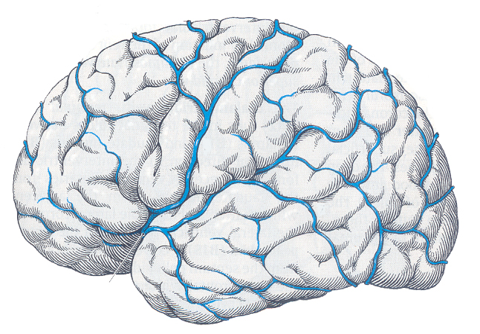
SUPERFICIAL VEINS
superior cerebral veins
superficial middle cerebral vein
inferior cerebral veins
Similarly, there are superior and inferior celebellar veins for the cerebellum.

Slide 19
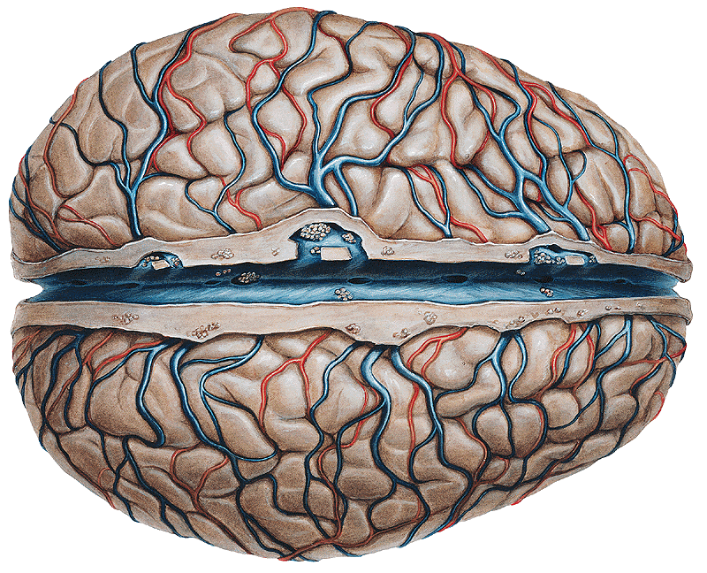
Superior cerebral veins open into the superior sagittal sinus or into the adjacent lateral lacunae.

Slide 20
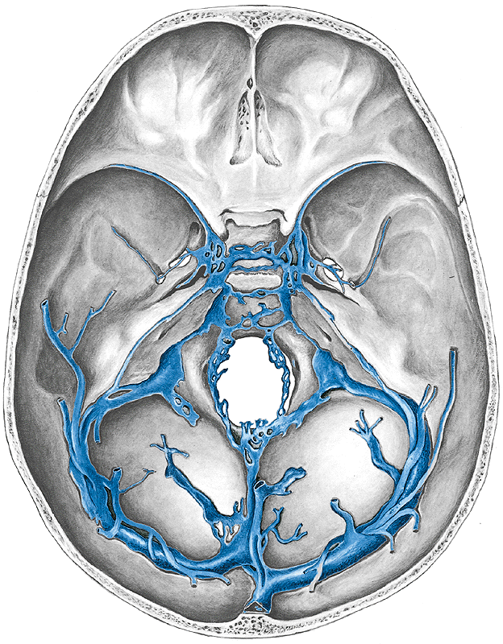
1.
Inferior cerebral veins drain mainly into the sphenoparietal (1), cavernous (2), superior petrous (3), and transverse (4) sinuses.
2.
3.
4.

Slide 21
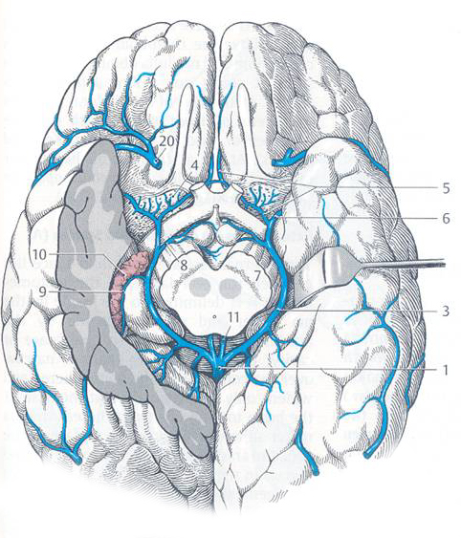
DEEP VEINS
ant. cerebral
deep middle cerebral
basal (Rosenthal)
great cerebral
(Galen)

Slide 22
Applied Anatomy

Slide 23
Congenital cerebral Aneurysam:-
These occurs mostly at the sites where two arteries joins in the formation of circle of willis.
The basic abnormality at these points is the congenital deficiency of the tunica media in the arterial wall. The aneurysms are berry- shaped. Hence they are generally termed as Berry aneurysam.
Subarachnoid Haemorrhage:-
Rapture of congenital berry aneurysms in the interpeduncular cistern.
It produces sudden severe pain in Head followed by mental confsion, the death may qucikly occur.
Occlusion of the posterior inferior cerebellar artery or one of its branches, or of the vertebral artery leads to Wallenberg syndrome, also called lateral medullary syndrome

Slide 24
Affected persons have difficulty in swallowing (dysphagia) .
Damage to the spinal trigeminal nucleus causes absence of pain on the ipsilateral side of the face, as well as an absent corneal reflex.

Slide 25
Thank u

